Slide 1

Empowering Insights, Igniting Action
Project: 2: Spotify Playlist Popularity Prediction
Data Dynamos
1

Slide 2




Our Team
Hardik Maisuria
Prithvi Prem
MS. Computer Science
BS. Business Data Analytics
Amrit Singh Johal
BS. Business Data Analytics and Molecular Biosciences & Biotechnology
Minor: Psychology and Sustainability
2

Slide 3
Project Defination
Understanding the factors that influence Spotify playlist popularity based on features such as the number of tracks, number of followers, duration, and number of edits.
3

Slide 4
Data
Spotify Playlist
4

Slide 5
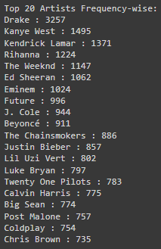
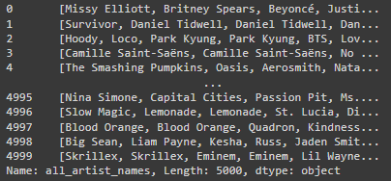
Feature Engineering
Calculated Popularity Score for each Playlist.
5

Slide 6
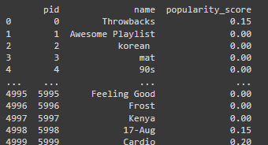
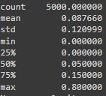
Feature Engineering
Calculated Popularity Score for each Playlist.
6

Slide 7
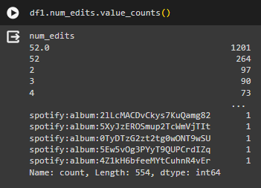
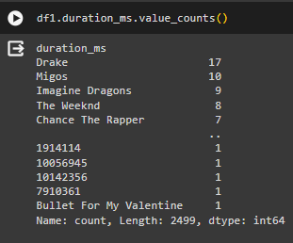
Preprocessing
Dropping these features due to inconsistent data types.
7

Slide 8
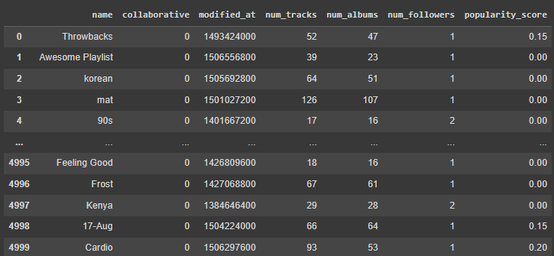
Preprocessing
Dropped ‘pid’ and
Converted Boolean values of Collaborative to 0 and 1
8

Slide 9
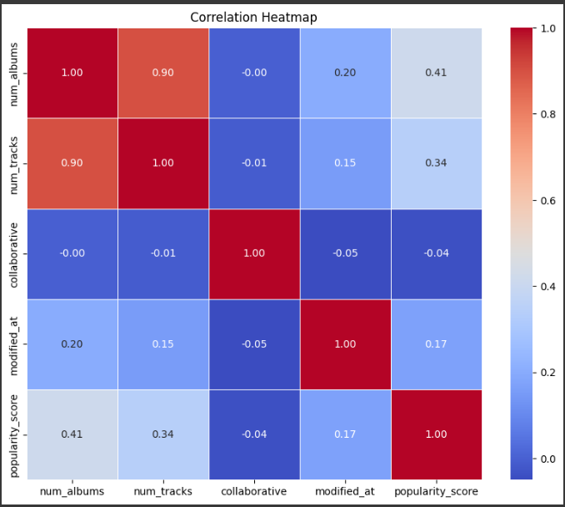
Exploratory Data Analysis
None of the input features are related to each other except num_albums and num_tracks.
9
Notes:
Data insights

Slide 10

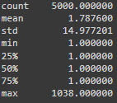
Exploratory Data Analysis
Target Variable
10
Notes:
Data insights

Slide 11


Regression Models
Mean Squared Error
R^2 Score
11
Notes:
Data insights

Slide 12
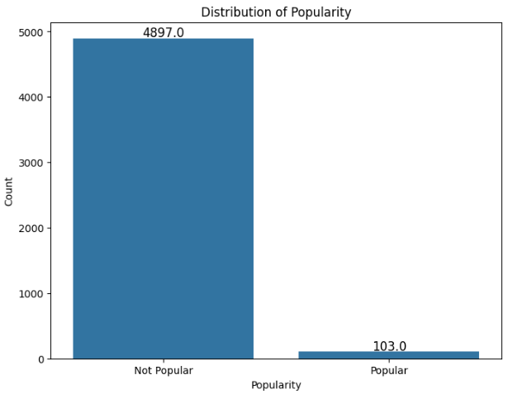
Classification
Converting Target Variable "Number of Followers" into Binary Class "Popular and "Not Popular"
Less than or equal to 5 -> Not Popular
Greater than 5 -> Popular
12
Notes:
Data insights

Slide 13

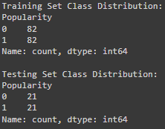
Under Sampling
Train-Test Data Split
13

Slide 14
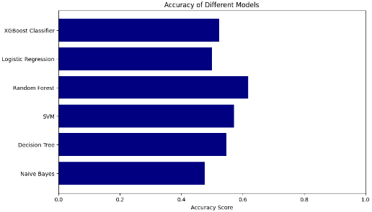
Results
14

Slide 15
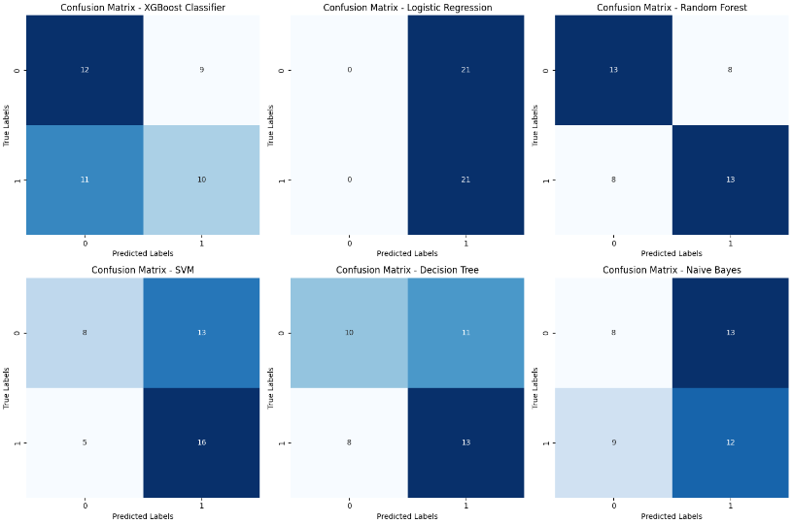
Results
15

Slide 16
Conclusions
R^2 Score is Negative for all the Regression Models
So models are getting overfit due to data imbalance.
Also input features may be irrelevant to target variable.
Also there are outliers in the dataset (Number of followers = 1038) which can be handled.
Accuracy is quite low for all the models.
After Under Sampling, maximum accuracy = 62%.
Reason behind this is Insufficient Data.
Irrelevant Data.
Main Reason: Data Quality.
16

Slide 17
Recommendations based on Conclusions
For Accurate Predictions of Popularity:
We need Balanced and Unbiased Dataset.
Relevant Features which signifies the reason for Popularity and Non-Popularity of a particular playlist.
Eg. Playlist with high number of followers, Features like Popular songs, Dominant Genres of songs, etc.
17

Slide 18
Thank You!
18

